Slide 1
Change the way we do devops for sql products using modern scalable technologies Aparna konduri

Slide 2
GoalS
Introduce modern scalable technologies and their applications for a better integrated Devops experience.
Illustrate the key concepts behind building and releasing SQL server by walking through CI/CD of a Database application using Azure and ADO.
Apply Devops to handle database projects.

Slide 3
Roadmap
Brief overview of git.
Introduction to Azure Devops.
Walk through Devops for SQL server through a demo application.
Get a better understanding of Devops at scale.

Slide 4
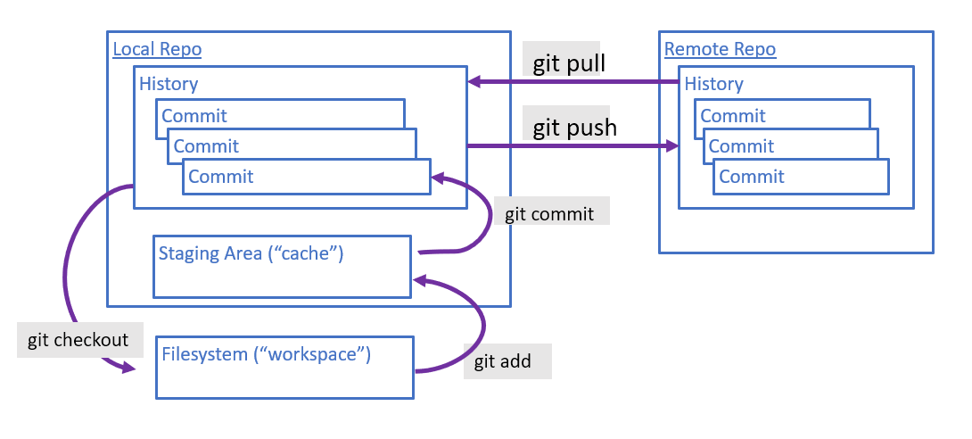
Git
Picture from Git Basics - Code Like This
Distributed Version Control
Learn Git from Resources to learn Git (try.github.io)
“Professional Git” by Brent Laster

Slide 5



Azure Devops
Azure Boards (Project Plans, work coordination)
Azure Repos (Source code repositories)
Integrated Devops experience
Azure Artifacts (Maven, Nuget feeds – private/public package feeds)
Azure Pipelines CI/CD (build and deployment)
Azure Test Plans (Manual and exploratory testing)
Notes:
Add order lifecycle arrows. Talk about Maven and Nuget.

Slide 6
ADO concepts
Board: Sprint board to track work. Epic ->* Feature -> *Project Backlog Item -> *Task
Artifact: Maven repositories and Nuget package manager to download software packages from. For example, ADO.NET to access database from C# code is exposed through NuGet Gallery | Net.Code.ADONet 4.0.73
CI/CD: Continuous Integration (checkin the code and build continuously) and CD (deploy the builds) pipelines.
Classic vs Yaml pipelines: In classic pipelines, drag and drop UI and builds and deployments are different. In Yaml pipelines, yaml is used for scripting the intent of the pipeline, and builds/deployments can be in the same file.

Slide 7
ADO concepts
Organization: Group of related projects, for example business divisions, enterprise structures.
Project: Related teams in a business division can all be under the same project. For example, SQL Server components can all be under the same project to be able to identify and track related work and share resources.
Repo: Each component will have their development work tracked in a source control backed repository.

Slide 8
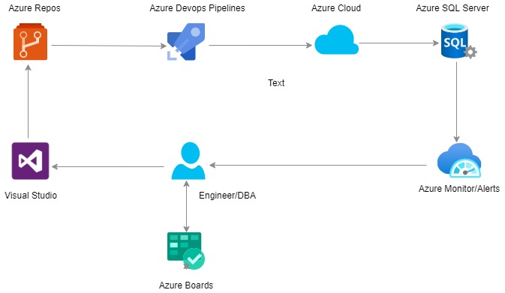
Overview

Slide 9
DEMO
Signup for Github.
Create an Organization/project/repo in Azure Devops.
Create a database from scratch using the scripts from “AdventureWorksLT” database.
Add the scripts to the source control repo in Azure Devops.
Build and deploy the database to Azure.

Slide 10
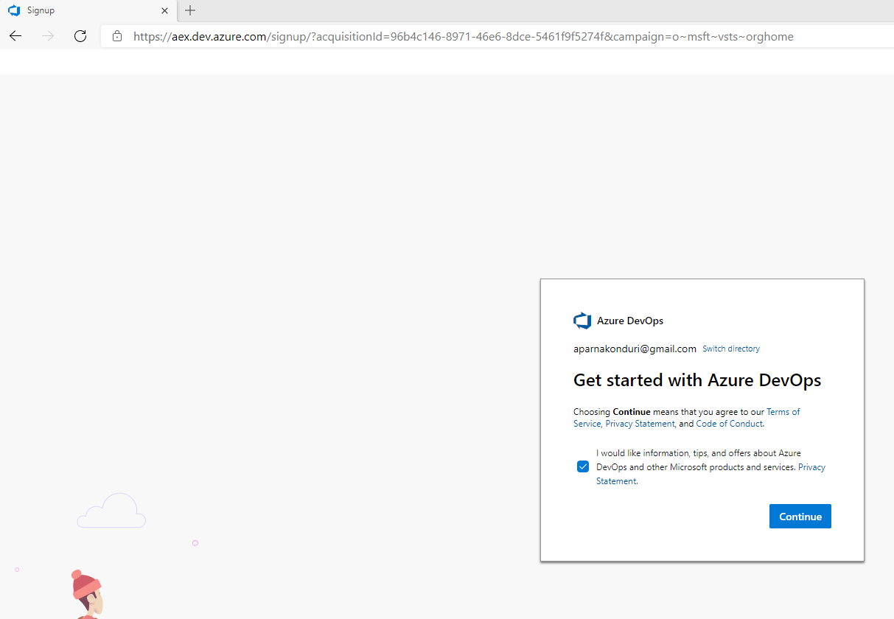
Sign into azure devops

Slide 11
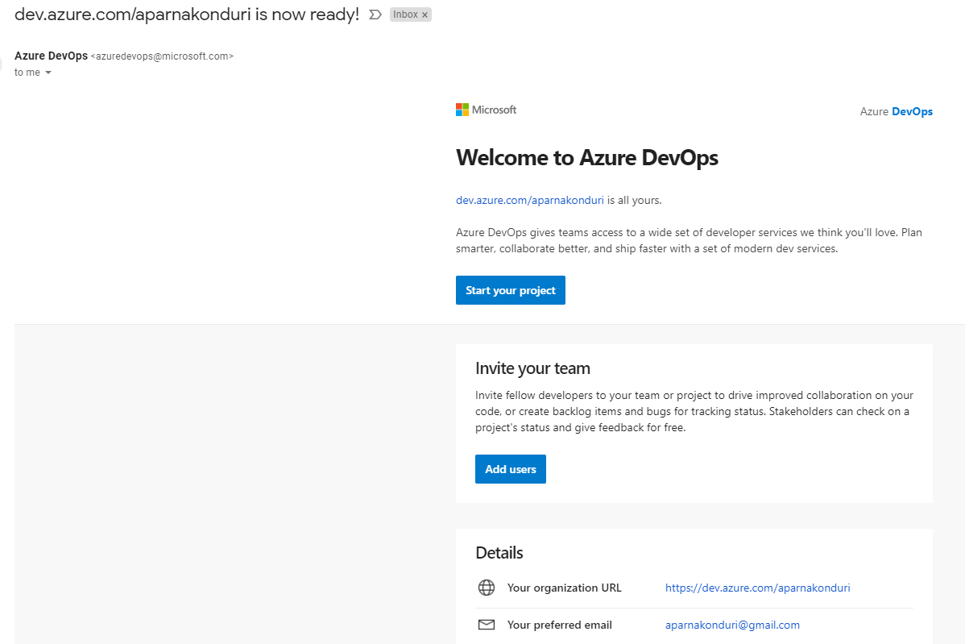
Notes:
Introduce Organization, project, repos

Slide 12
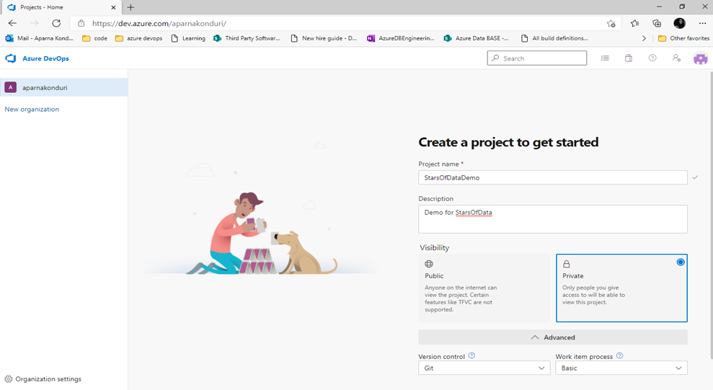
Create a project

Slide 13
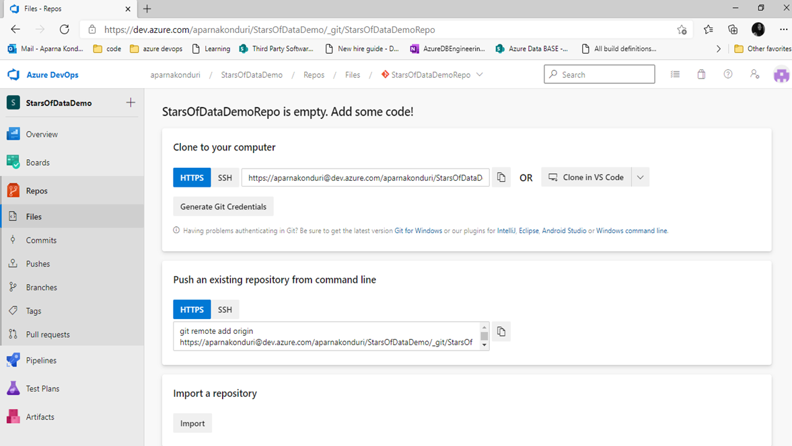
Add code to the repo
Notes:
Show PR experience

Slide 14
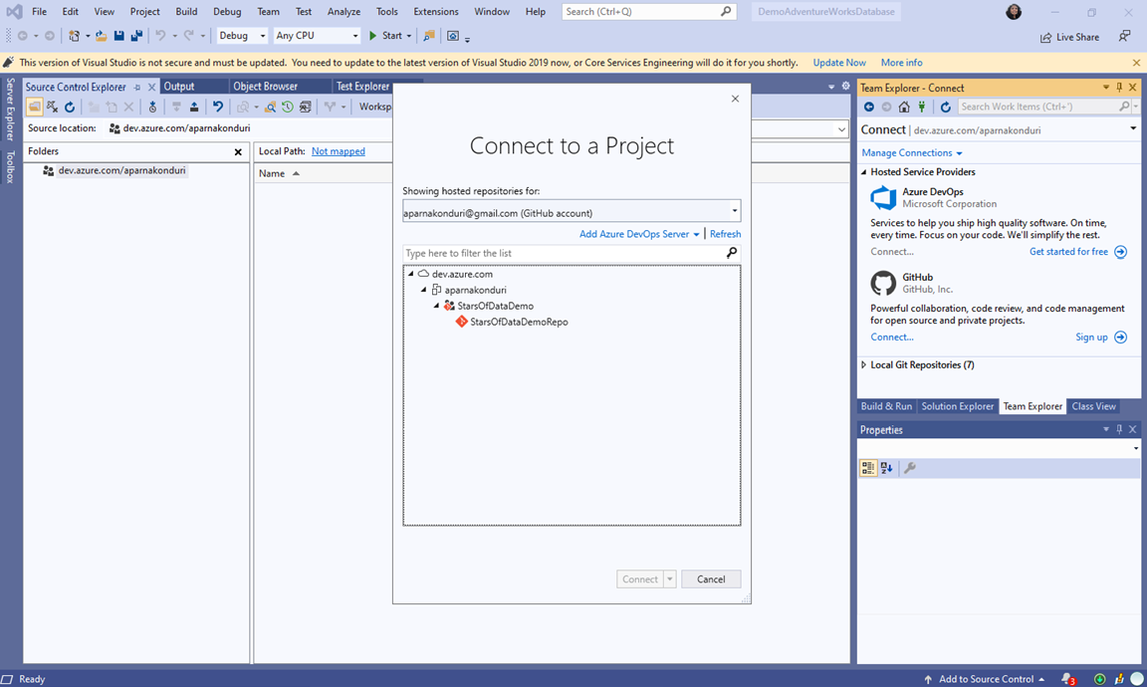
Visual studio - connect to the Azure DevOps project

Slide 15
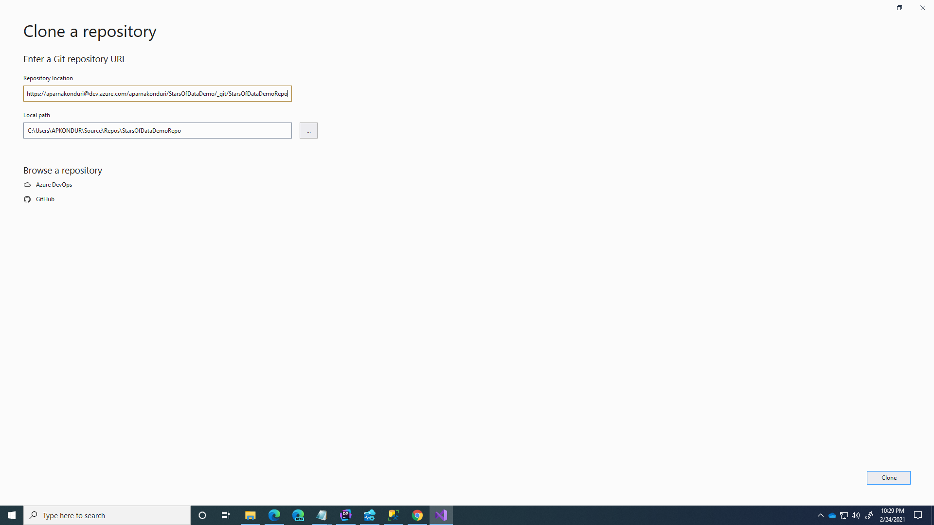
Clone the repo from azure devops to create a local workspace

Slide 16
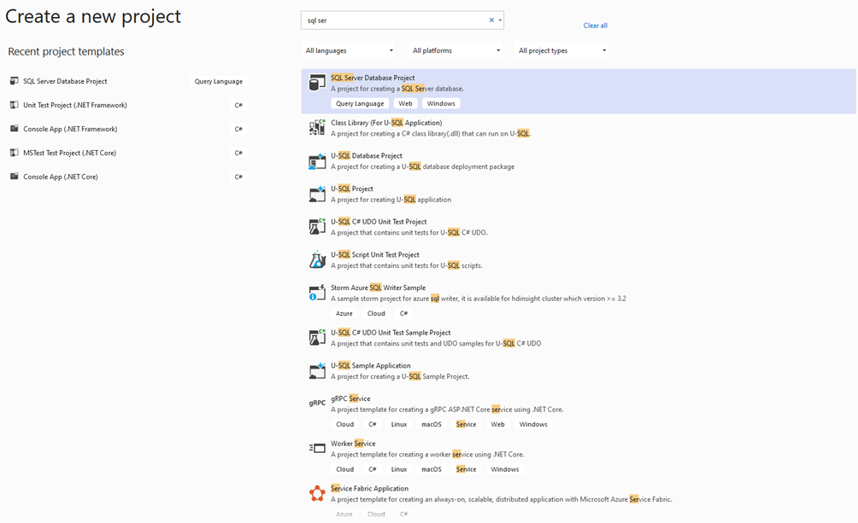
Create database project
Notes:
Increase the font and show the Visual Studio context.

Slide 17
import ADVENTUREWORKSLT DATABASE into the project
Needed some tweaks to the downloaded scripts to compile in Visual Studio.
Notes:
Downloaded OLTP scripts for “AdventureWorks” database from AdventureWorks sample databases - SQL Server | Microsoft Docs. Scripts are only compatible with SQL Server 2012 edition and did not compile with the latest version of Visual Studio.
Needed to throw away “AdventureWorks” database and install “AdventureWorksLT” database. (Logged into Azure account, created Azure SQL Server in the cloud which came with “AdventureWorksLT” database as a default.)
Then exported the scripts out of the database to be imported into the database project and stored under source control.
Scripts for “AdventureWorksLT” database did not compile. Needed to add a missing sequence statement.
“create sequence [SalesOrderNumber] as bigint start with 1 increment by 1. GO”

Slide 18
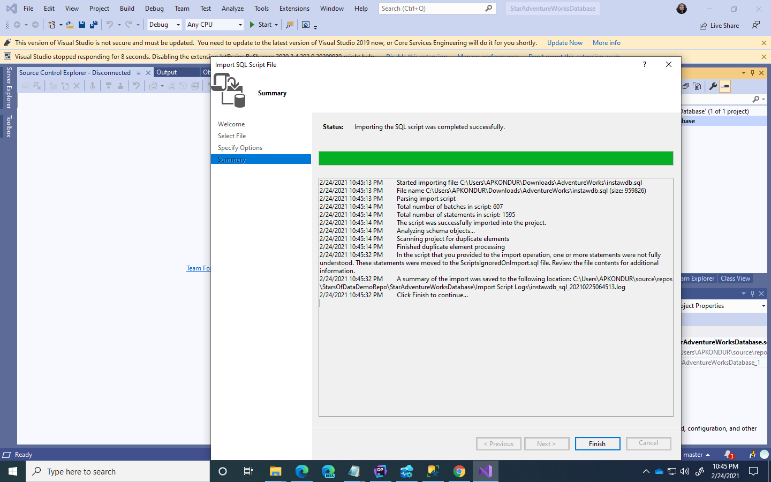

Slide 19
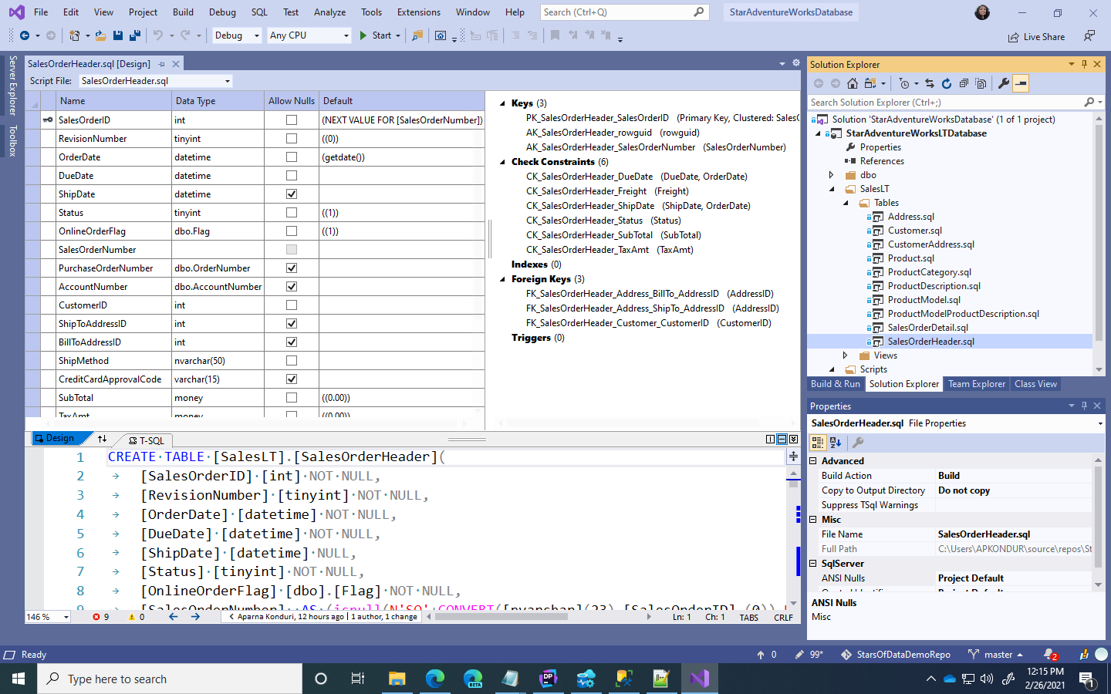

Slide 20
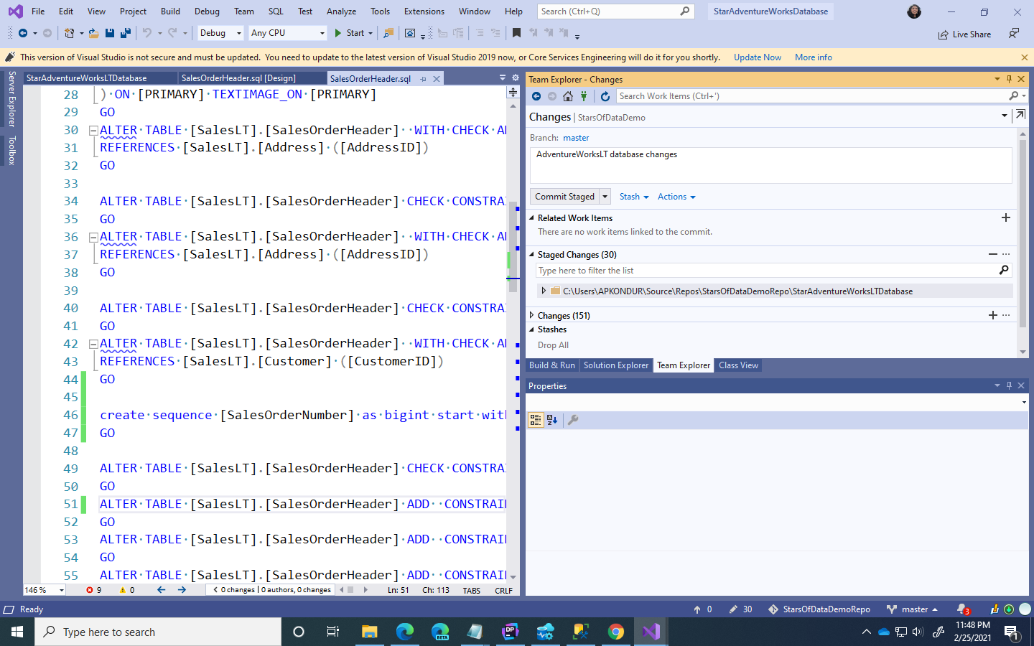

Slide 21
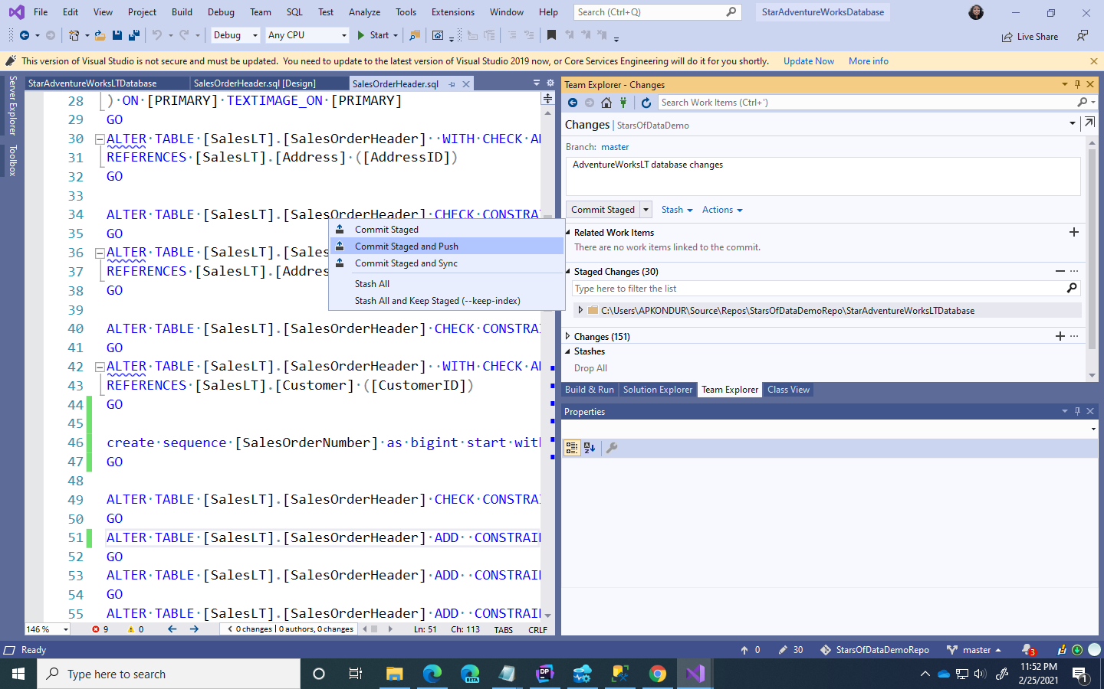

Notes:
Add a slide of PR for branch to master

Slide 22
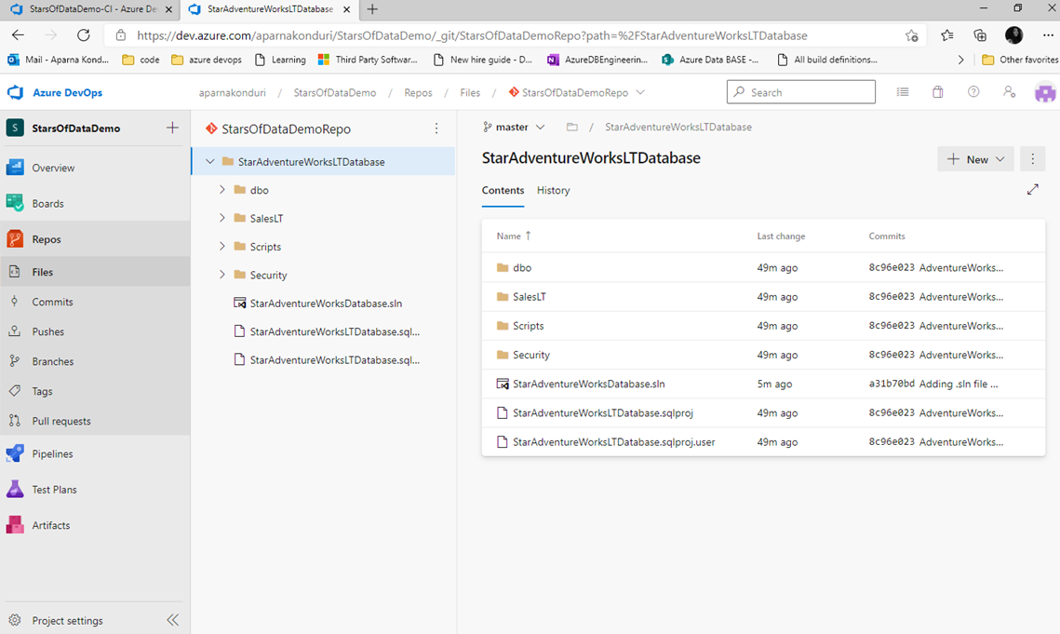
Azure devops repo is reflected with files

Slide 23
Don’t checkin changes to master directly
Master serves as the central branch in a git repo.
Work from many engineers get merged into master.
To prevent polluting master, perform development work on a user’s private git branch and pushed to user’s remote branch
Changes from the user’s remote branch can then be merged into master using “Pull Requests”
A “Pull Request” serves as a guard before merging into master.
Changes are played against master and built to make sure there are no errors.
Code review process where the changes are reviewed by someone other than the author and approved.
Once a pull request is approved, then code can merge into master.

Slide 24
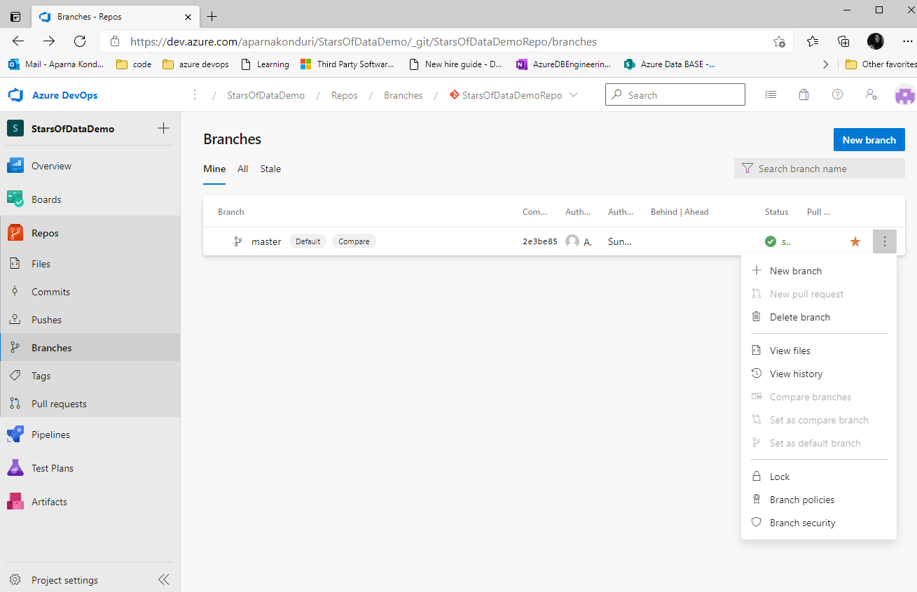
branch policies to mandate pull requests on code checkins

Slide 25
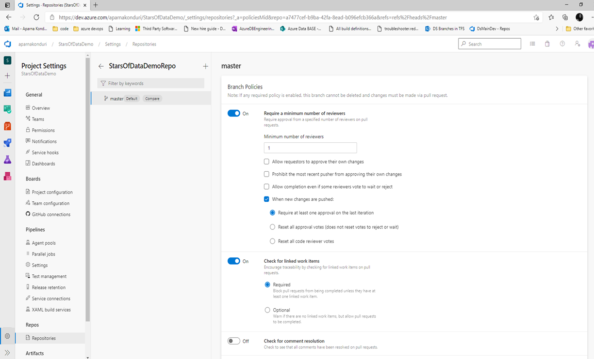
Sample pull request policy

Slide 26
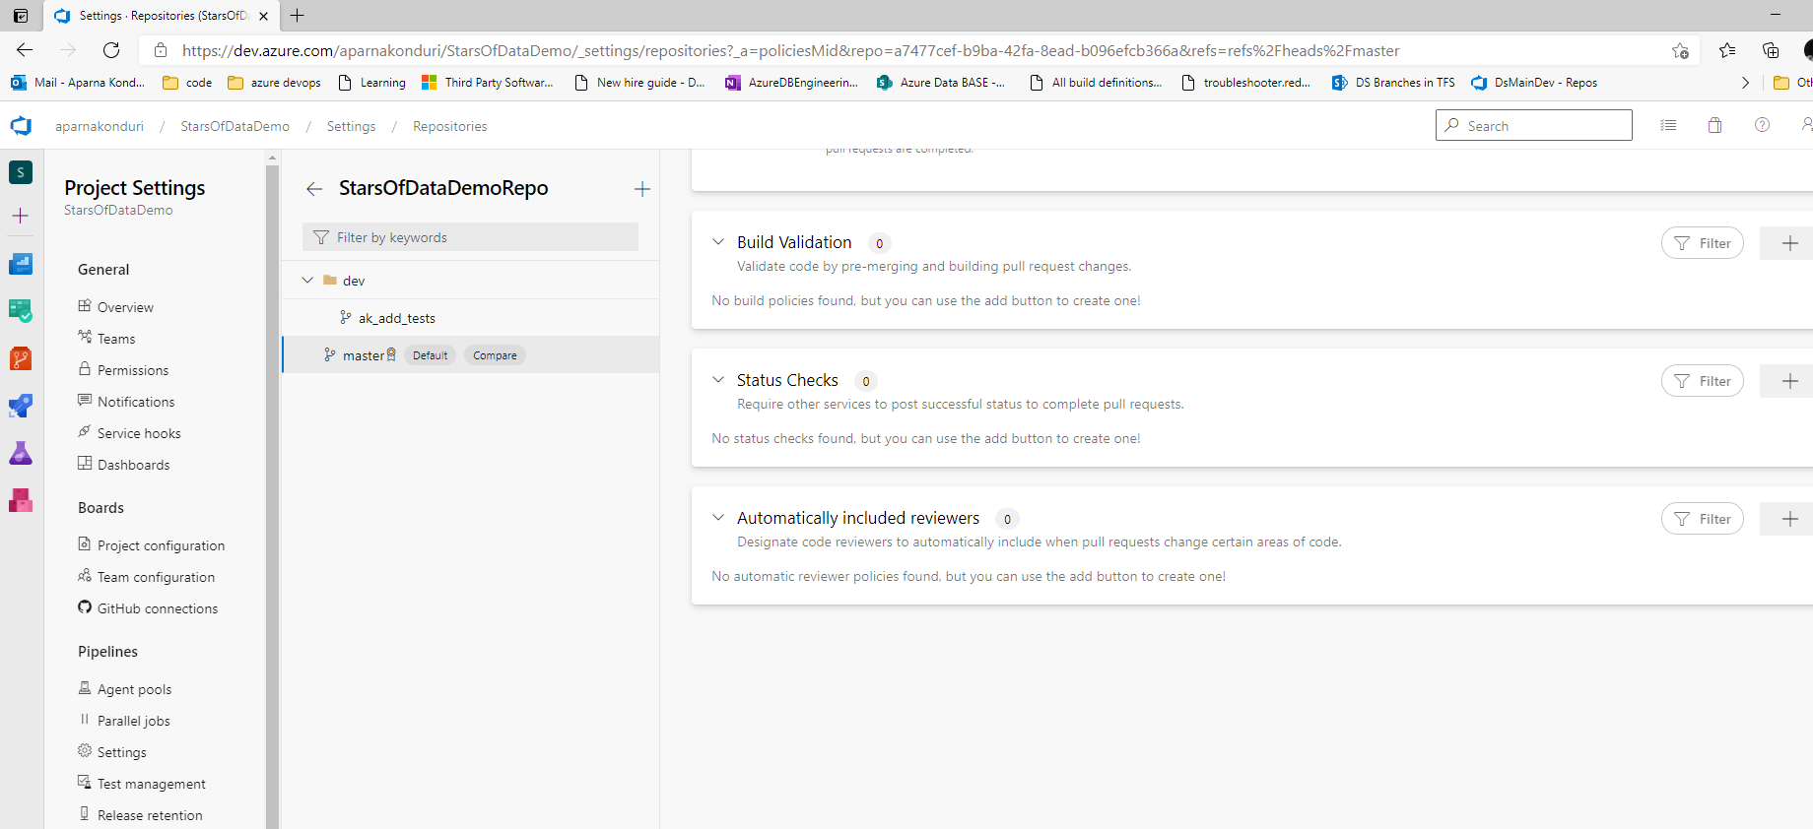

Sample pull request policy

Slide 27
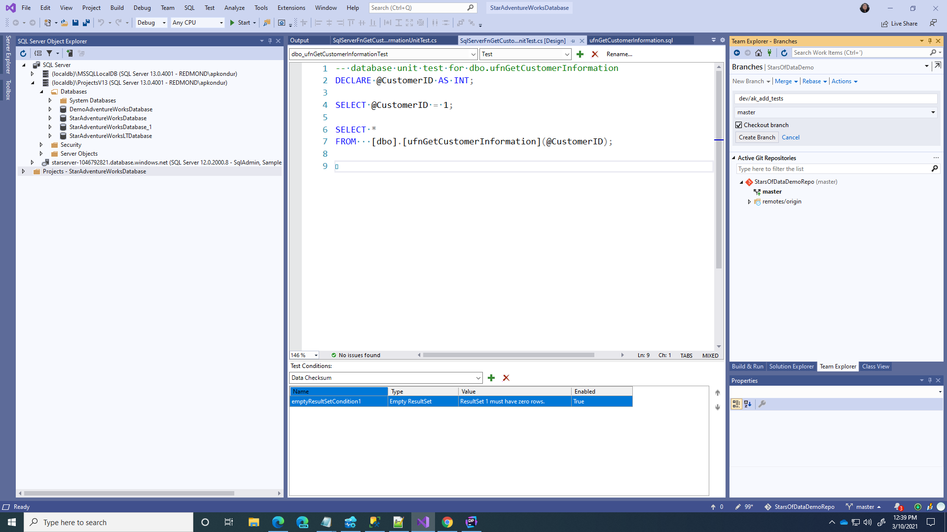
Walk through the pull request experience - Create a local branch

Slide 28
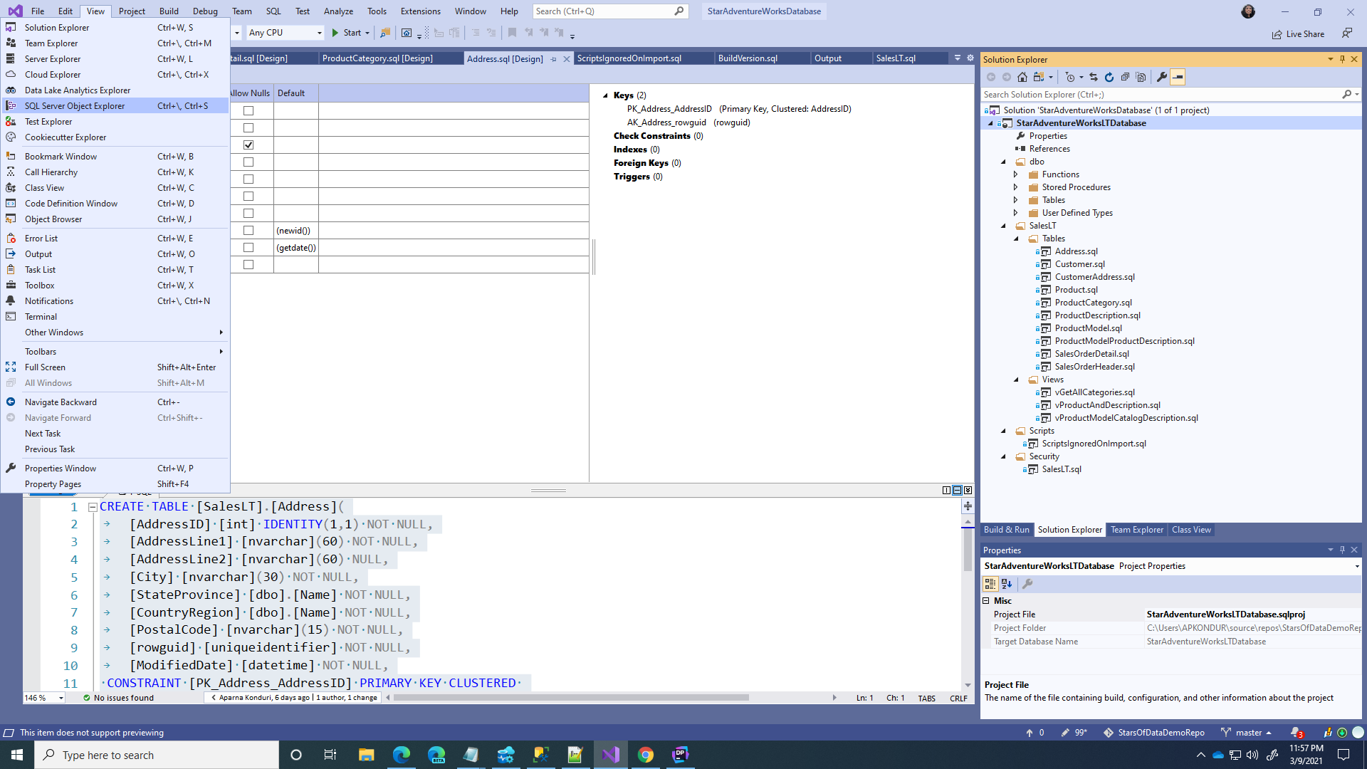
Illustrate pull request – add Unit tests to the project

Slide 29
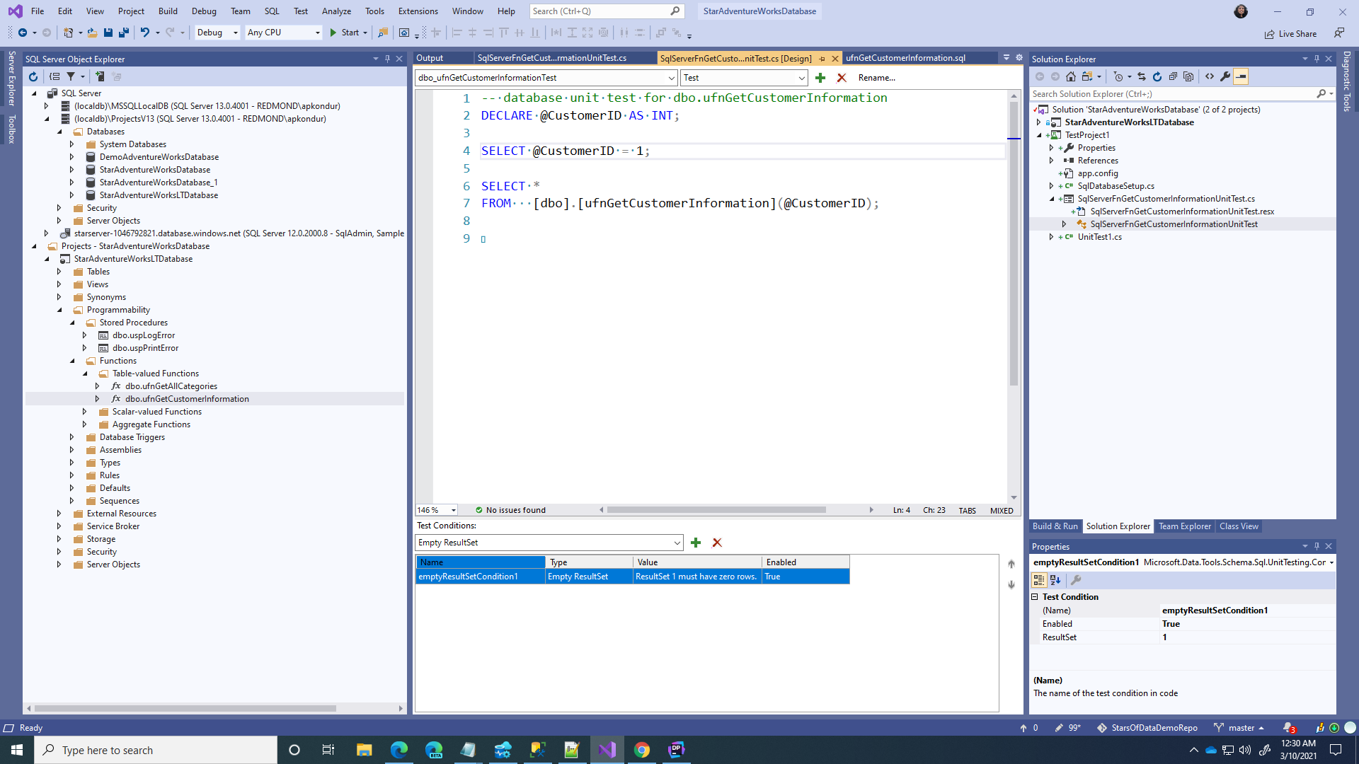
Unit testing of database scripts

Slide 30
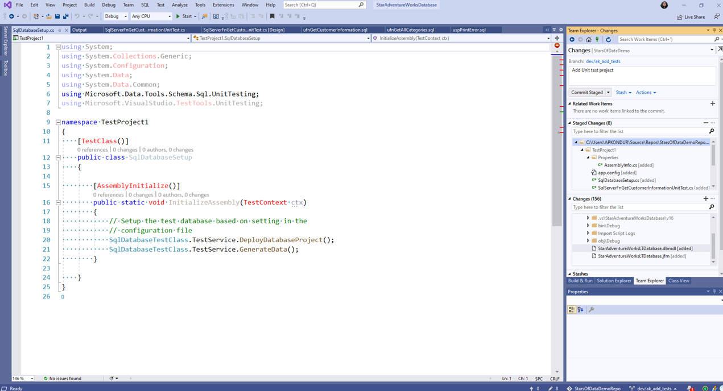
Push the local changes to a remote branch

Slide 31
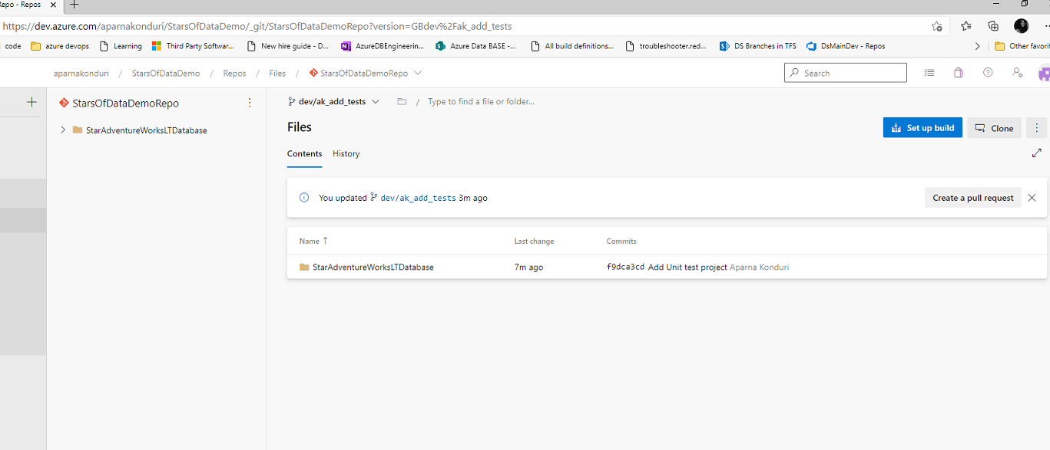

Pull request experience

Slide 32
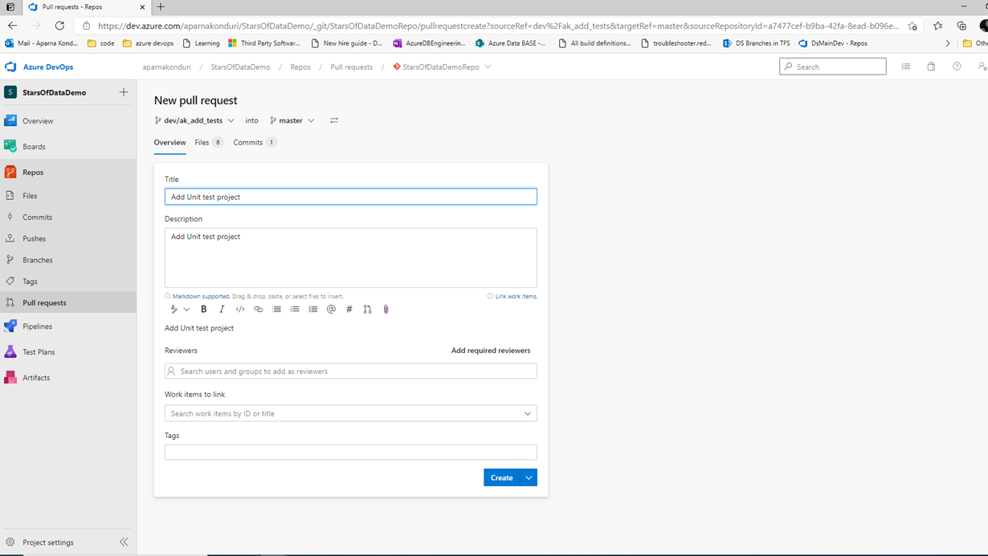
Pull request experience

Slide 33
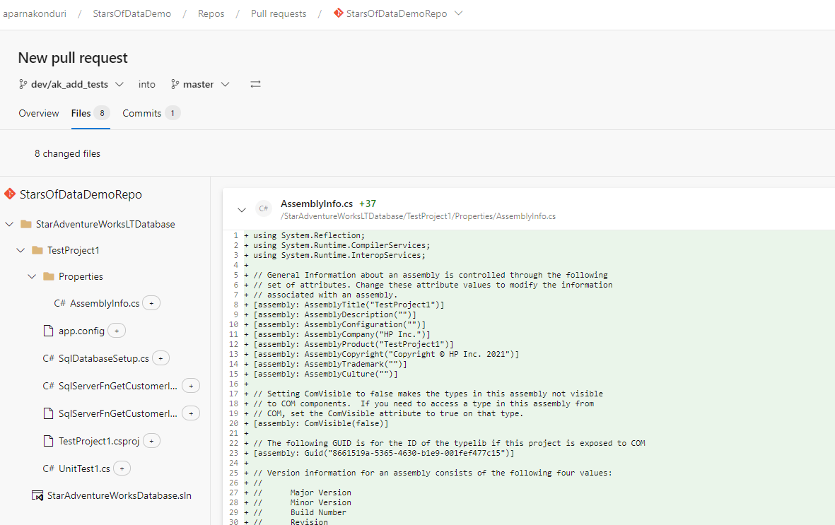
Pull request experience

Slide 34
Approve Pull requests
Review the pull requests from your team members
If changes look good, then approve the pull requests and code gets merged into master.

Slide 35
Demonstrate CI/CD pipelines
Classic Pipelines (Drag and drop UI experience)
Yaml Pipeline (script based), can be generated easily by exporting yaml from a classic pipeline. Advantages: Version Control, powerful

Slide 36
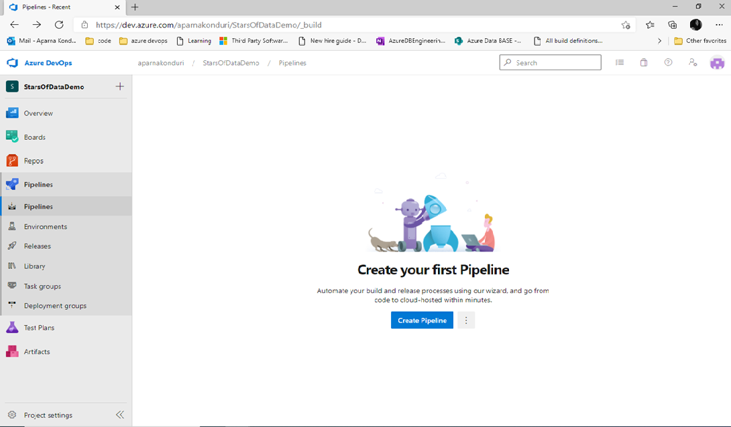

Slide 37
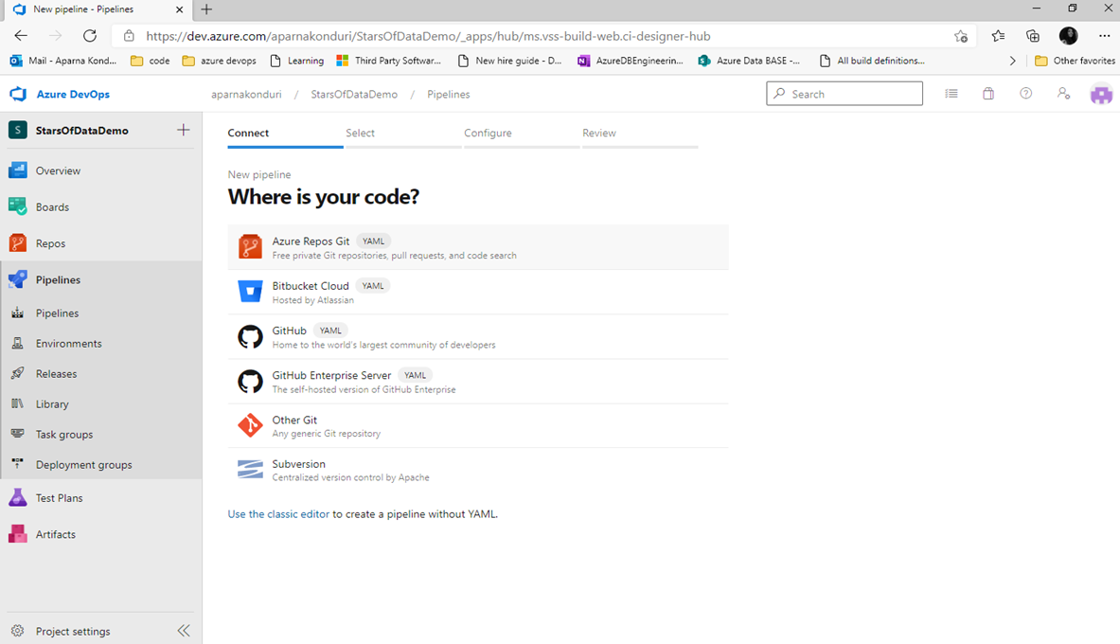



Slide 38
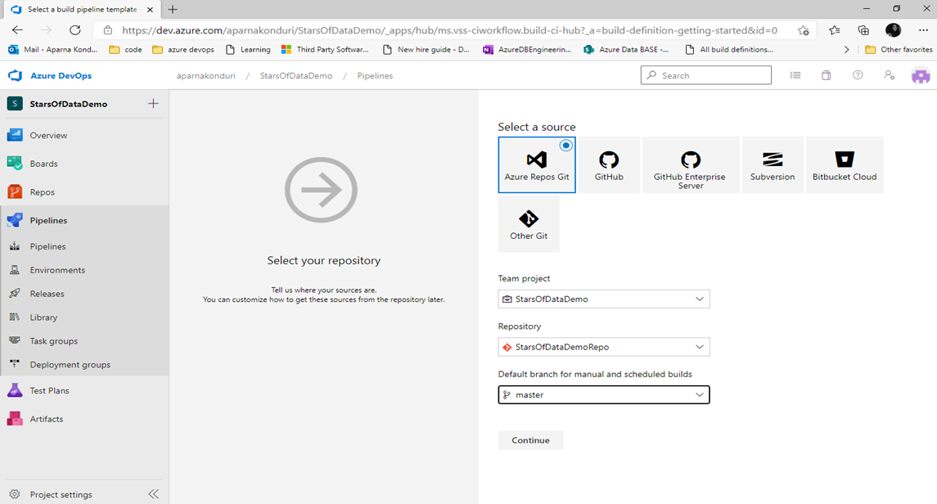

Slide 39
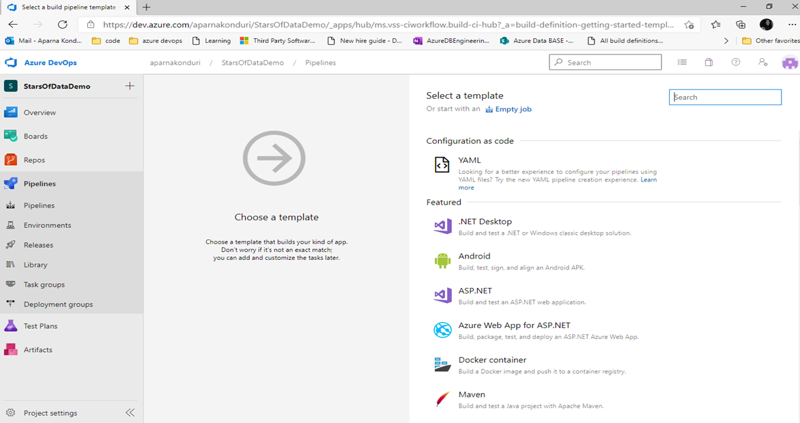


Slide 40
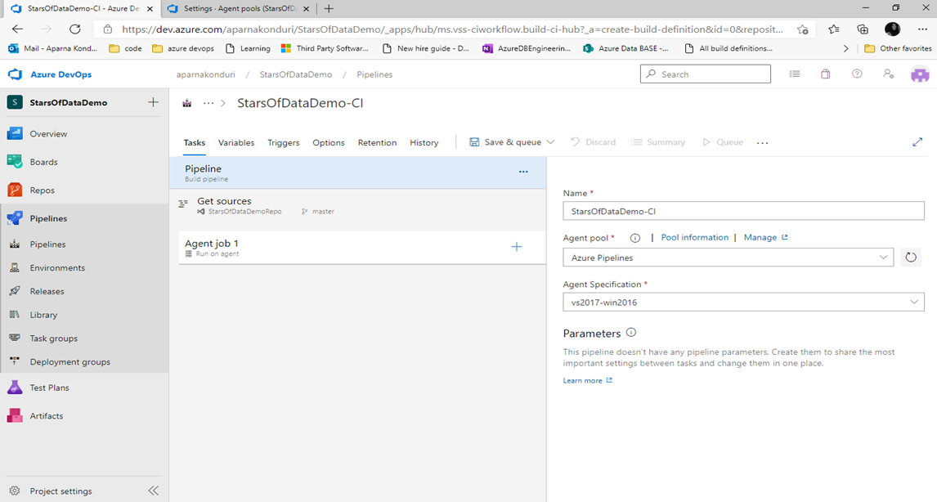

Slide 41
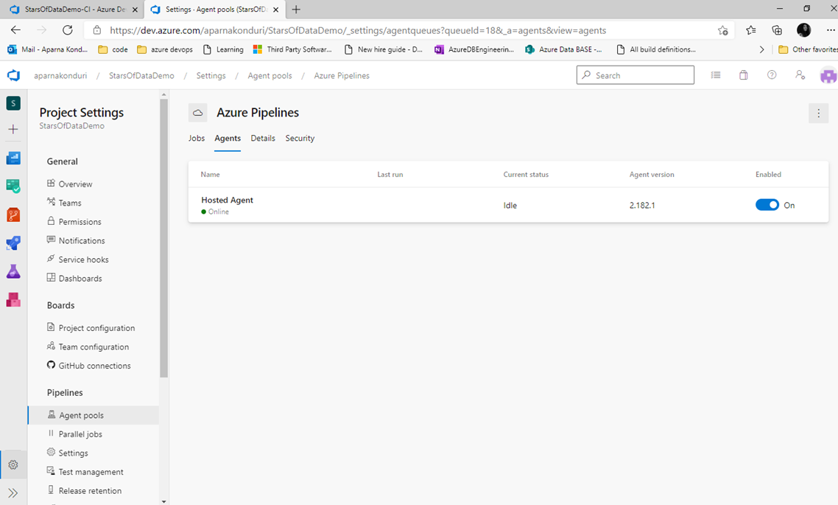

Slide 42
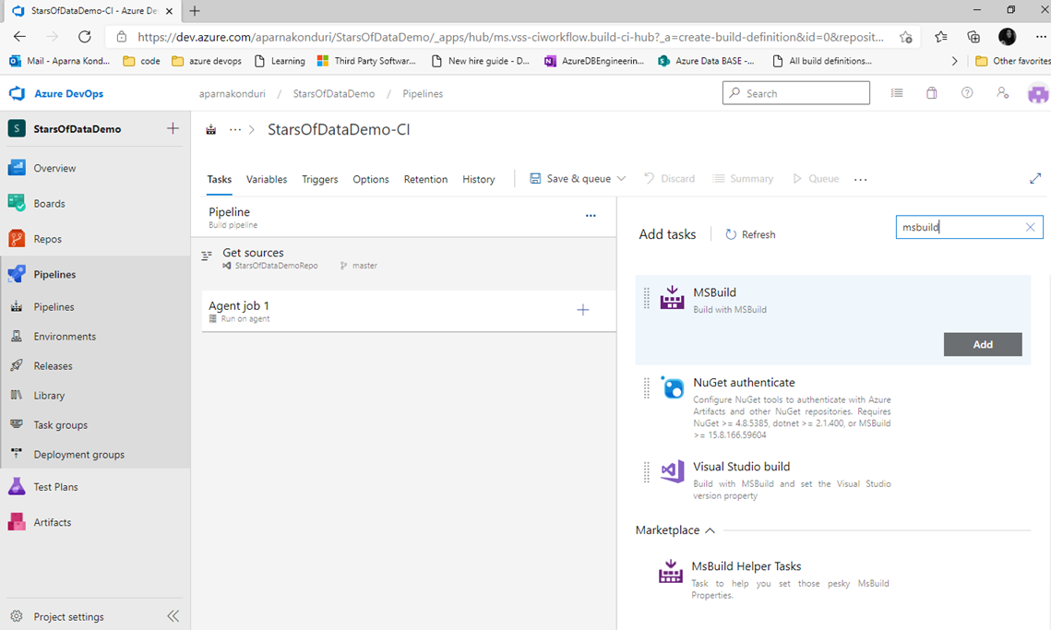
Notes:
Point to doc for custom tasks or marketplace

Slide 43
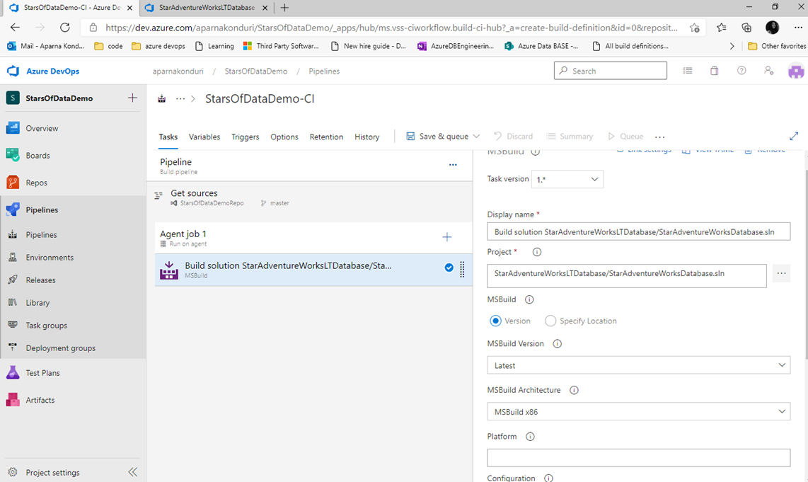
Notes:
Show parallel build option

Slide 44
Speed up the build
Add /p:CmdLineInMemoryStorage=TRUE to MSBUILD arguments (validate the database model using physical memory instead of an internal database transaction queue)
Notes:
Look into tools to determine unnecessary dependencies (look into the context of db – no cross-database dependencies ? ETL processing?)

Slide 45
Azure devops pipelines
Predefined variables - Azure Pipelines | Microsoft Docs that can be used in scripting.

Slide 46
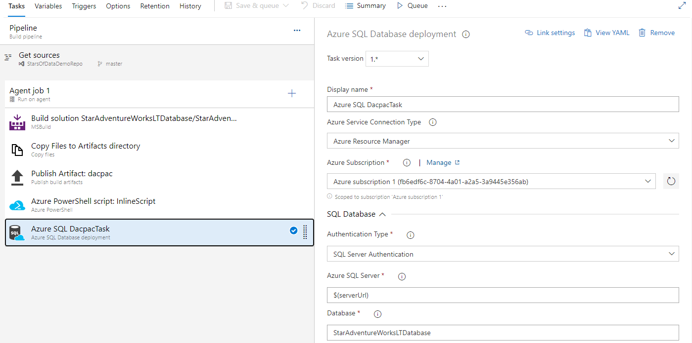

Slide 47
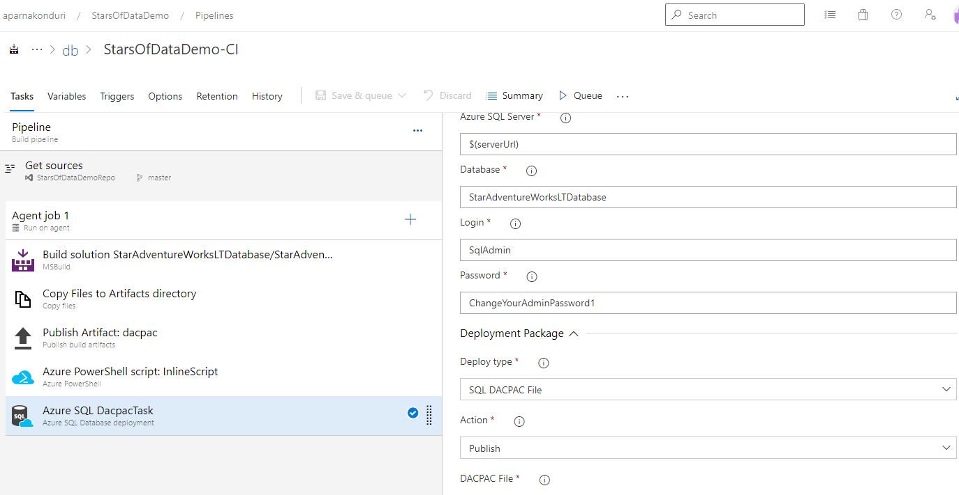

Slide 48
Pipeline status
Built Database project and generated .dacpac file (dacpac contains a model of all database objects)
PowerShell: Create a single database - Azure SQL Database | Microsoft Docs
Removed SampleDatabase parameter to prevent the default AdventureWorksLT schema to be able to deploy my own version of AdventureWorksLT database
Noticed build failures and opened the firewall to a range of IP addresses to be able to access the validate database from “Query Editor” in Azure Portal

Slide 49
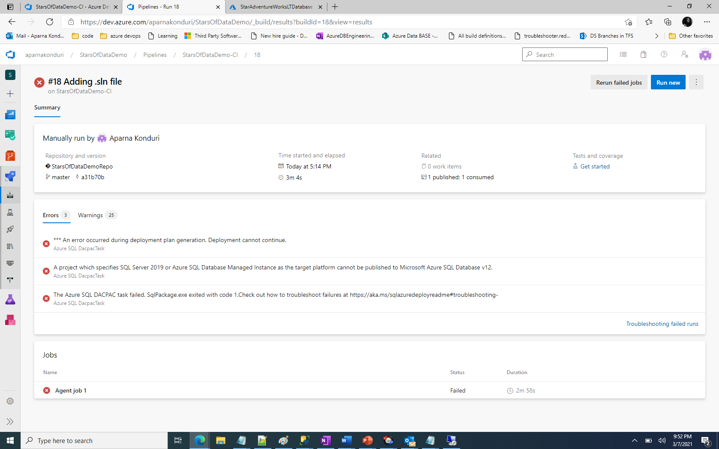
Deployment of .dacpac failed

Slide 50
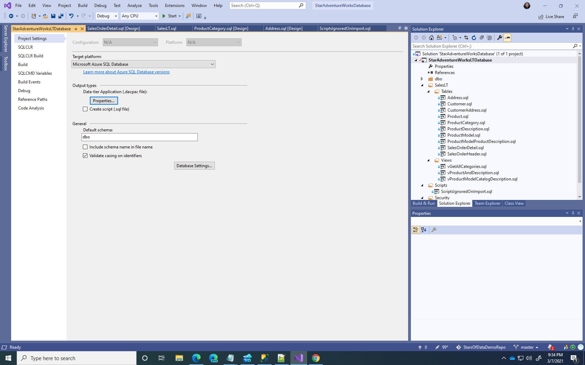
Change the target platform

Slide 51
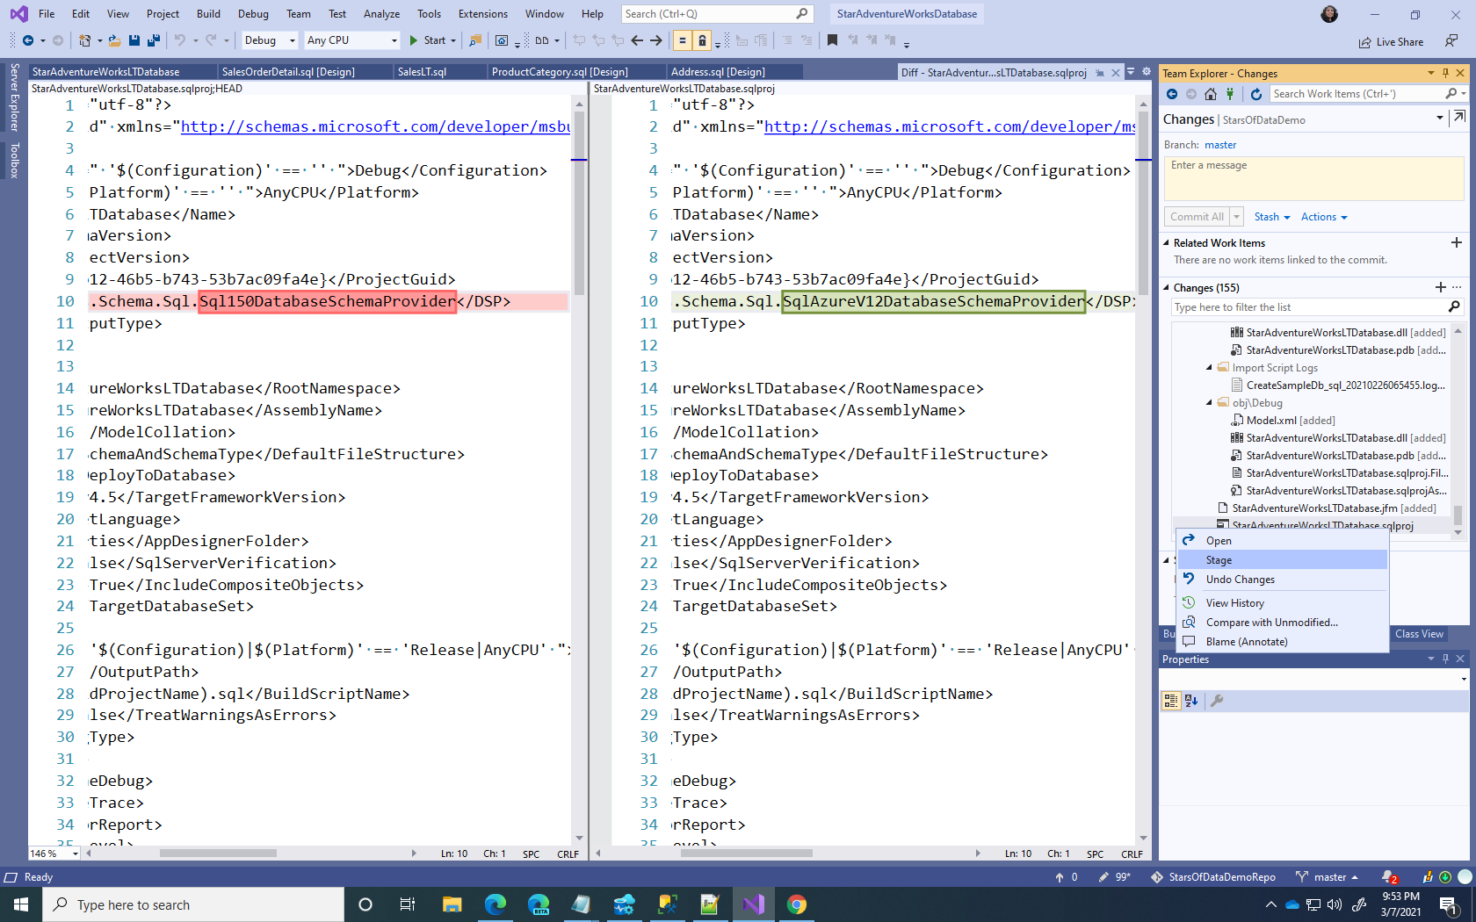

Slide 52
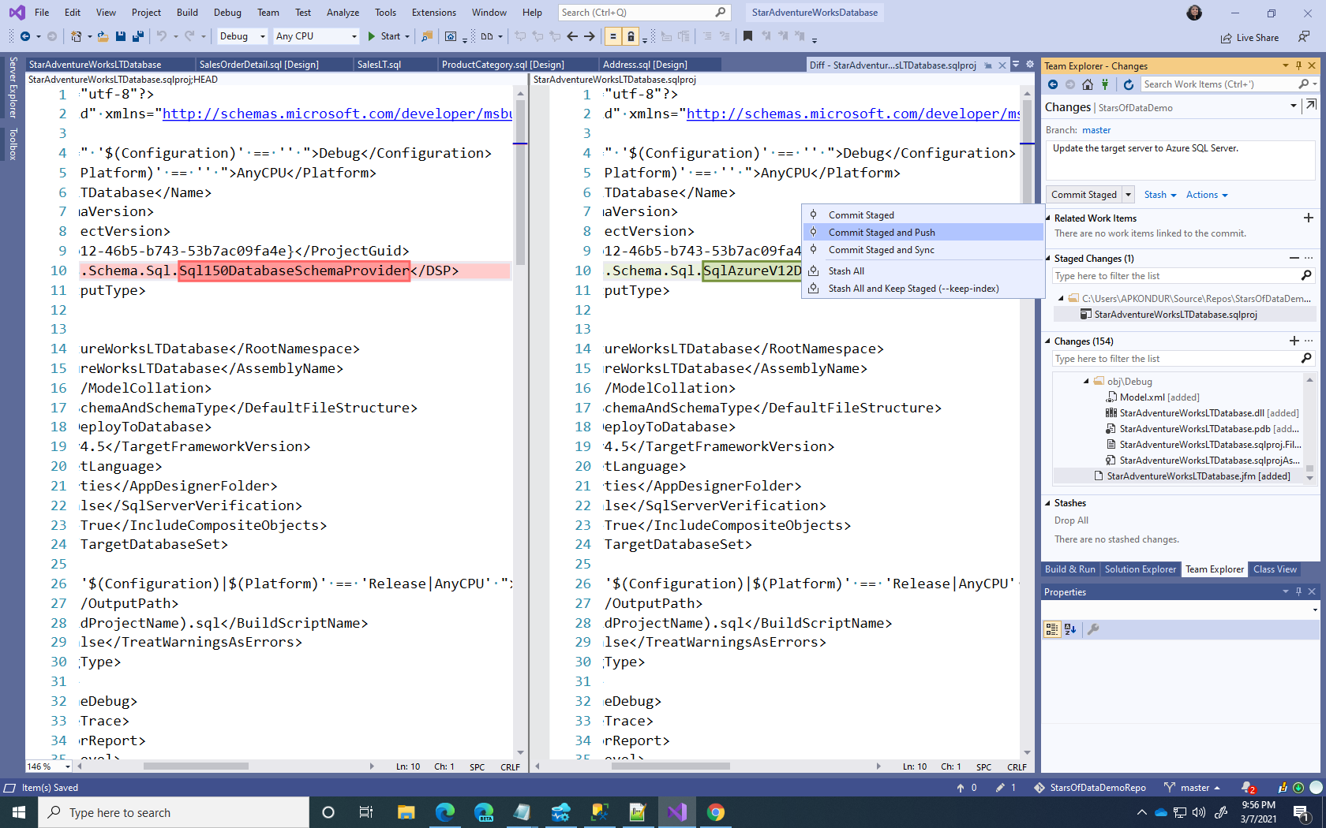

Slide 53
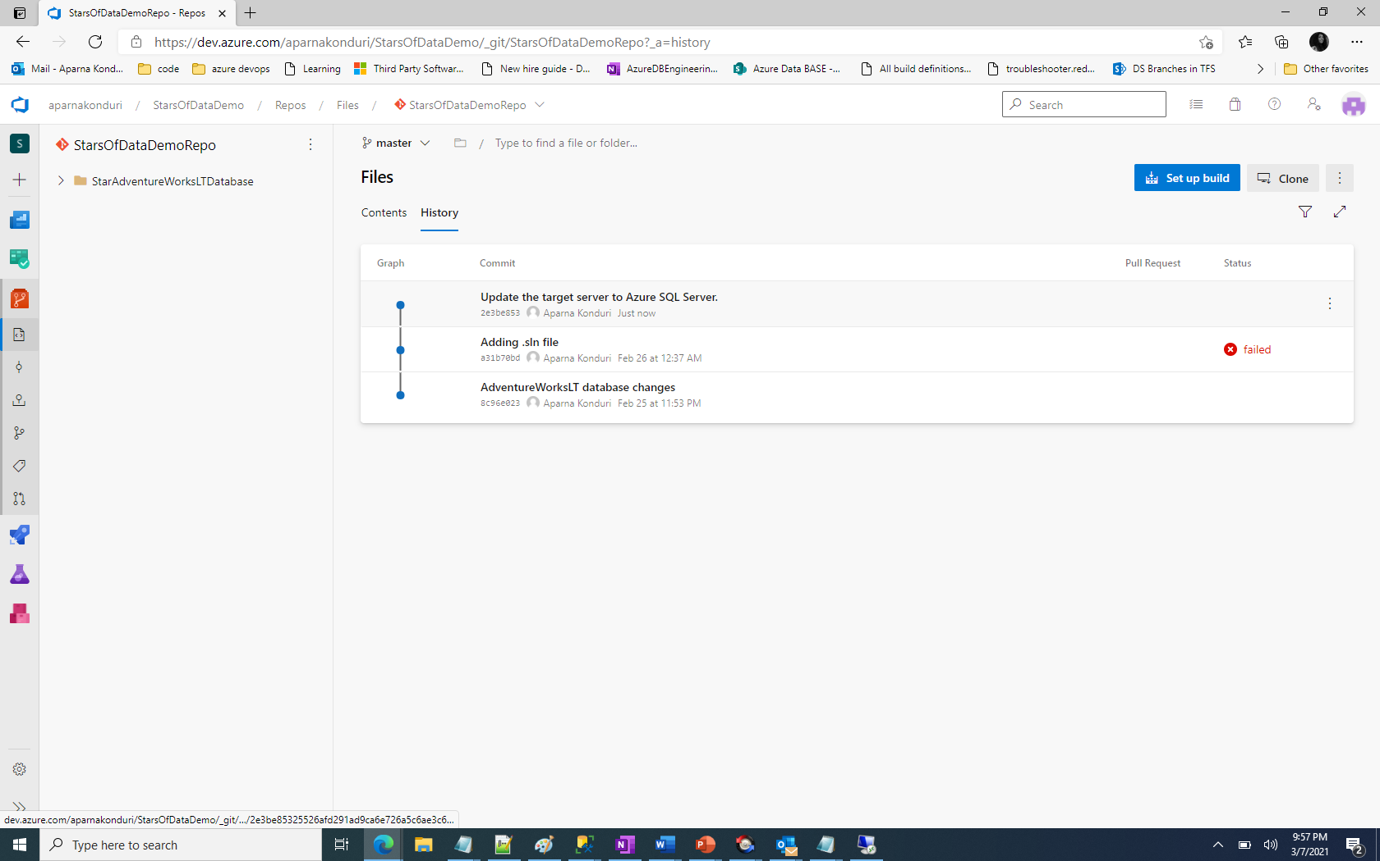

Slide 54
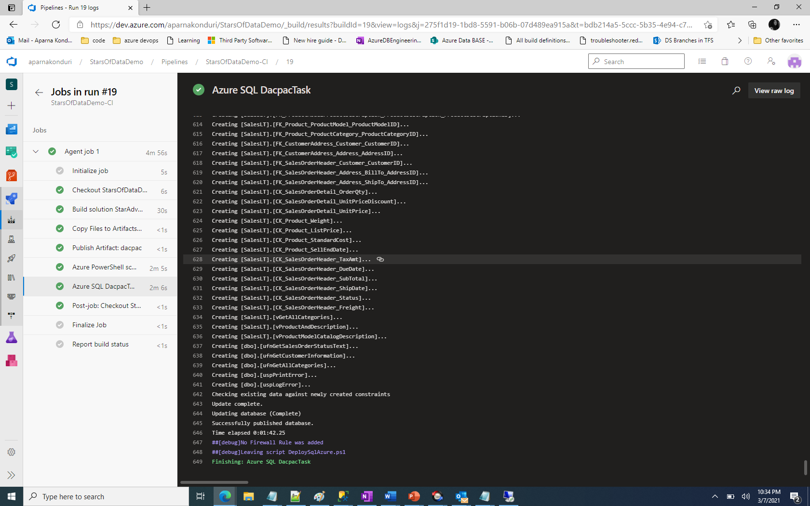

Slide 55
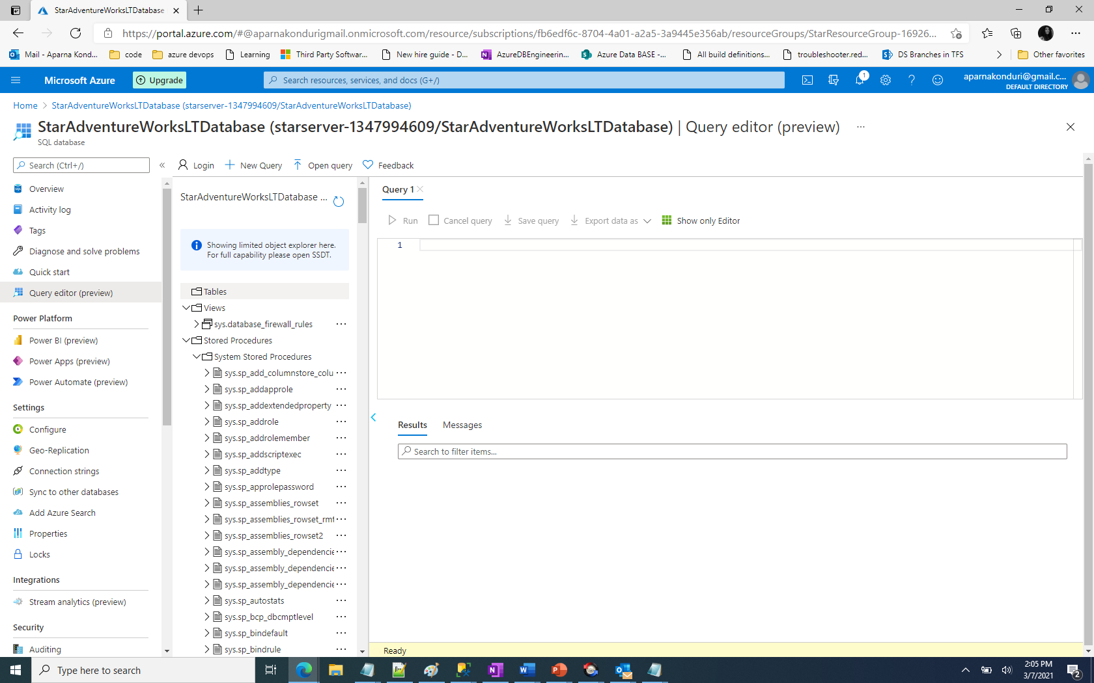

Slide 56
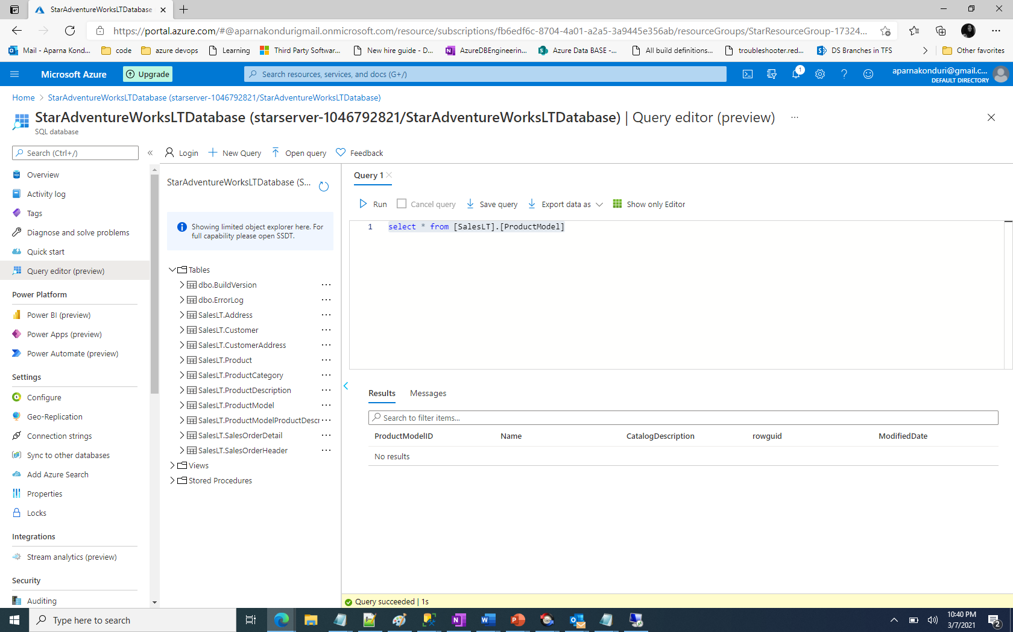
Notes:
AdventureWorksLT database is deployed successfully.

Slide 57
Use cases
Test databases
Each pipeline run can create a new test database for validation before creating the production database.
Large databases
Instead of a single large database project, create multiple database projects based on the different schemas. For example, DBA tables and customer tables can be two separate projects. Similarly, static lookup tables can be a separate project from the dynamic tables.
Building each project generates dacpac and the delta is played over an existing database.
Speedup the build using /p:CmdLineInMemoryStorage=True

Slide 58
recap
SQL Project is in git
Azure Devops pipelines to build and deploy the SQL database to Azure Cloud.
Use the Query Editor in Azure Portal to validate the changes.
Recommendations for handling large projects and speeding up the builds.

Slide 59
Questions/Follow up?

Slide 60

About me
I have years of experience working on scalable systems and cloud architectures.
I have been at Microsoft for a year as a Senior Software Engineer on SQL Server Devops team. Prior to that I worked at Amazon as a Senior backend engineer.
Aparna Konduri on LinkedIn.

